Slide 1
Multivariate Visualization
Multivariate variate data visualization involves visualizing more than one data value in a single renderer. The programming language R, which is frequently used for data visualization, provides a number of tools for the visualization of multivariate data.
Scatterplot
Violin Plot
Radar Chart
Line Graph

Slide 2
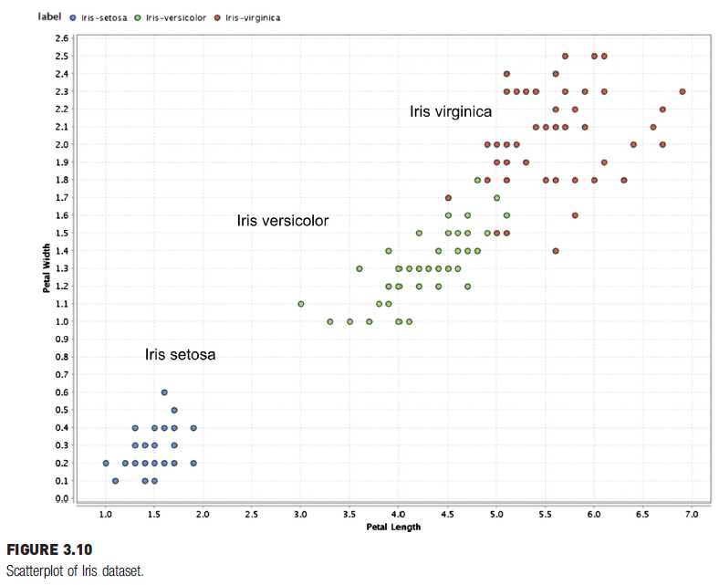
Scatterplot
Fig. 3.10 shows the scatterplot between petal length (x-axis) and petal width (y-axis).
These two attributes are highly correlated, because this is a measurement of the same part of the flower.

Slide 3
Observations
Iris Setosa (Blue):
Clearly separated from the other two species.
Petal lengths range from approximately 1.0 to 2.0, and petal widths range from 0.1 to 0.6.
Iris Versicolor (Green):
Petal lengths range from 3.0 to 5.0, and petal widths range from 1.0 to 1.8.
Versicolor partially overlaps with Virginica, especially at higher petal lengths and widths, but it is generally distinct.

Slide 4
Observations
Iris Virginica (Red):
Petal lengths range from 4.5 to 7.0, and petal widths range from 1.4 to 2.5.
Virginica is well-separated from Setosa but overlaps with Versicolor at smaller petal lengths and widths.
Petal Length and Petal Width are highly effective features for distinguishing the three species. There appears to be a positive correlation between petal length and width for all three species, with petal width increasing as petal length increases.
This visualization suggests that using Petal Length and Petal Width together can be effective in classifying the Iris species, especially in separating Iris setosa from Iris versicolor and Iris virginica.

Slide 5
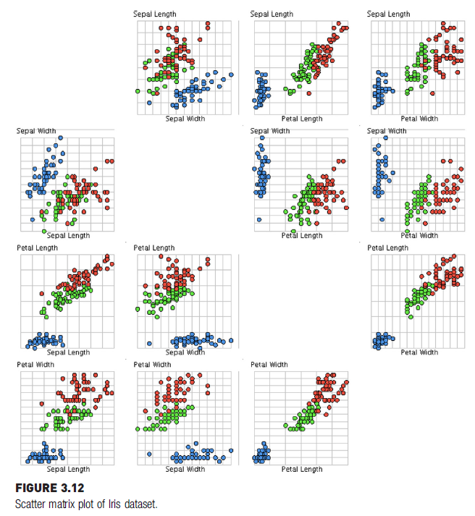

Scatter Matrix
A scatter matrix for all four attributes in the Iris dataset is shown in Fig. 3.12.
The color of the data point is used to indicate the species of the flower.
Since there are four attributes, there are four rows and four columns, for a total of 16 scatter charts. Charts in the diagonal are a comparison of the attribute with itself; hence, they are eliminated.

Slide 6
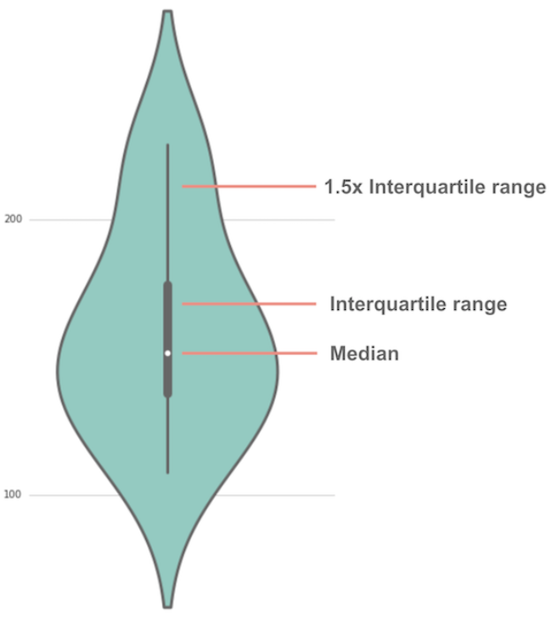


Violin Plot
Violin Plot is a method to visualize the distribution of numerical data of different variables.
A violin plot is a hybrid of a box plot and a kernel density plot, which shows peaks in the data.
Unlike a box plot that can only show summary statistics, violin plots depict summary statistics and the density of each variable.

Slide 7
How to read a violin plot
the white dot represents the median
the thick gray bar in the center represents the interquartile range.
the thin gray line represents the rest of the distribution.

Slide 8
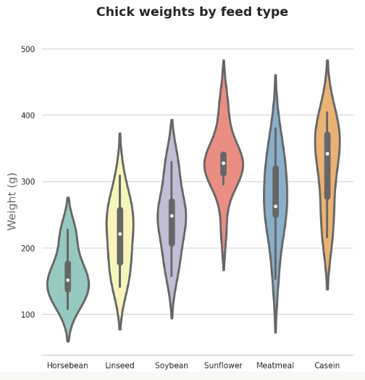
Example of a violin plot
About the data
The table modeanalytics.chick_weights contains records of 71 six-week-old baby chickens (aka chicks) and includes observations on their particular feed type, and chickens weight.The thick gray bar in the center represents the interquartile range.
This violin plot shows the relationship of feed type to chick weight.
Each violin represents the distribution of chick weights for a specific feed type.

Slide 9
Example of a violin plot
Observations:
Horsebean:
Lower weights overall, with most chicks clustering around 100–200 grams.
Smaller variability compared to other feed types.
Linseed:
Moderate weights, with a median weight slightly above 200 grams.
Distribution is relatively symmetric, with fewer extreme values.
Soybean:
Similar to linseed but with a slightly higher range and median weight near 300 grams.

Slide 10
Example of a violin plot
Observations:
Sunflower:
The broadest range of weights.Median is higher (around 300–400 grams), but there is a wide spread in values.
Smaller variability compared to other feed types.
Meatmeal:
Narrower distribution, with most weights concentrated around 300 grams.
A symmetric distribution is evident.Distribution is relatively symmetric, with fewer extreme values.
Casein:
The highest weights overall, with a median around 400 grams.
Tight distribution around the higher weight range.

Slide 11
Example of a violin plot
The shape of the distribution (extremely skinny on each end and wide in the middle) indicates the weights of sunflower-fed chicks are highly concentrated around the median.

Slide 12
Radar Chart
A radar chart is an informative visual tool in which multiple variables (three or more) and compared on a two-dimensional plane. For this, we will create different axes emerging from a common central point. In most of the cases, all the axes are equally distributed and uniformly drawn from each other. Sometimes, the axes are also connected to each other to form different grids that make it easier for us to plot the spider chart.

Slide 13
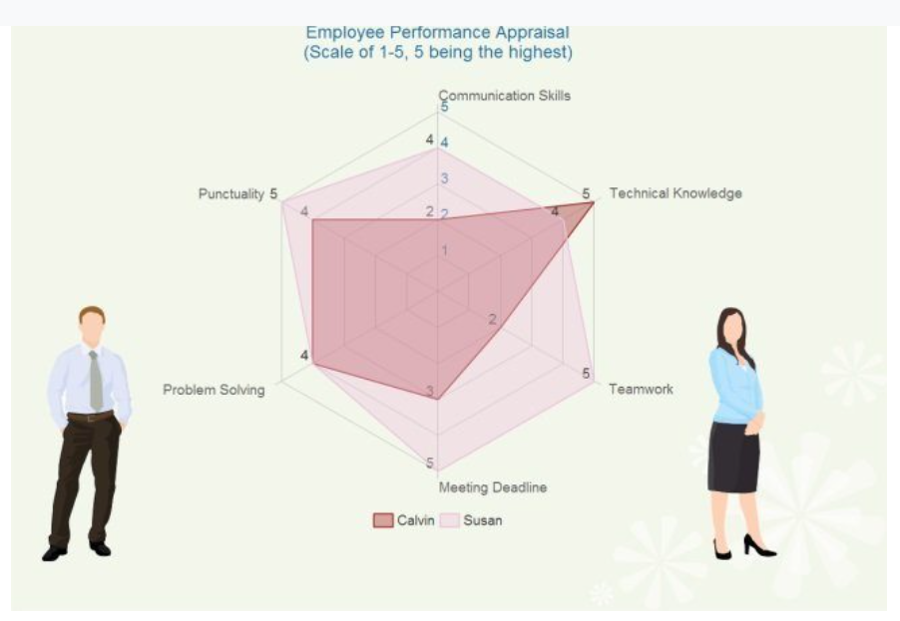
Example of a Radar Chart
Employee Performance Chart :
In this example, you can see how the overall performance of two employees is compared using a spider graph.
To compare them, we have used variables like punctuality, communication skills, technical knowledge, teamwork, etc. Furthermore, both the employees are allocated points (1-5) for each of these variables and are compared accordingly.

Slide 14
Line Graph
Line graphs, also called line charts, are used to represent quantitative data collected over a specific subject and a specific time interval.
All the data points are connected by a line.
Line graph gives a graphical representation of the changes that had occurred over a given period of time.

Slide 15
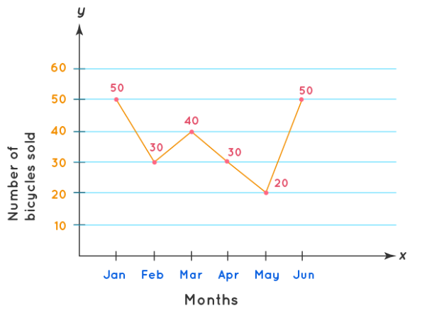
Example of a Line Graph
The line graph shown above represents the sale of bicycles by a bicycle company from the month of January till JuneAll the data points are connected by a line.
Here, the x-axis represents the time interval and the y-axis represents the number of bicycles sold each month.
In the example shown, the number of bicycles sold in the month of January is 50. Similarly, in the month of February 30 bicycles were sold.

Slide 16
Example of a Line Graph
We can interpret this data for each month using the data point.
The line segment connecting these individual data points gives a picture of whether the sale of bicycles is in an increasing or decreasing trend.

